Slide 1
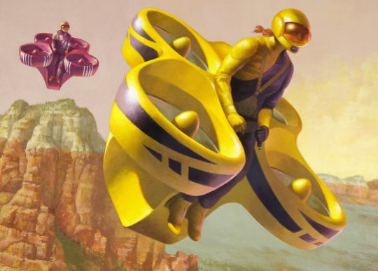
Hardware Review 2
Figure 1-Novakinetics concept art [1]
Steve Sorden, Travis Byakeddy, Corey Marcum, Nathaniel Shaul

Slide 2
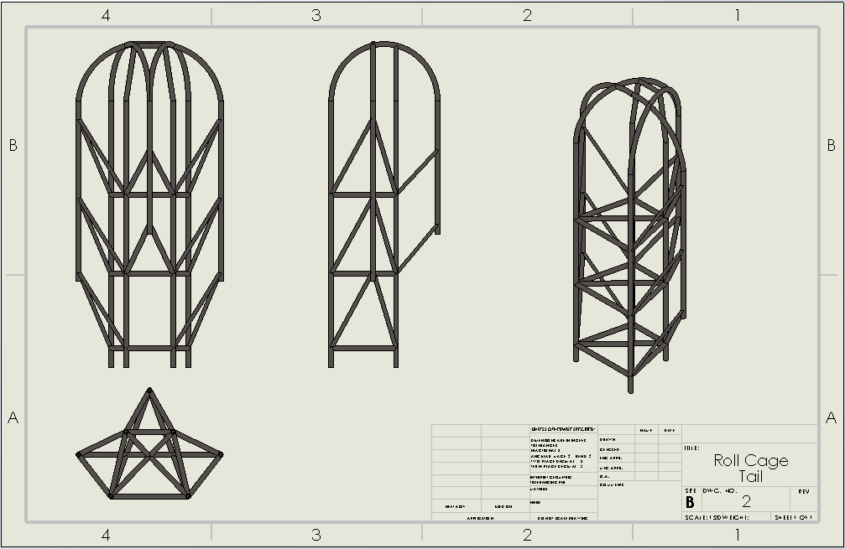
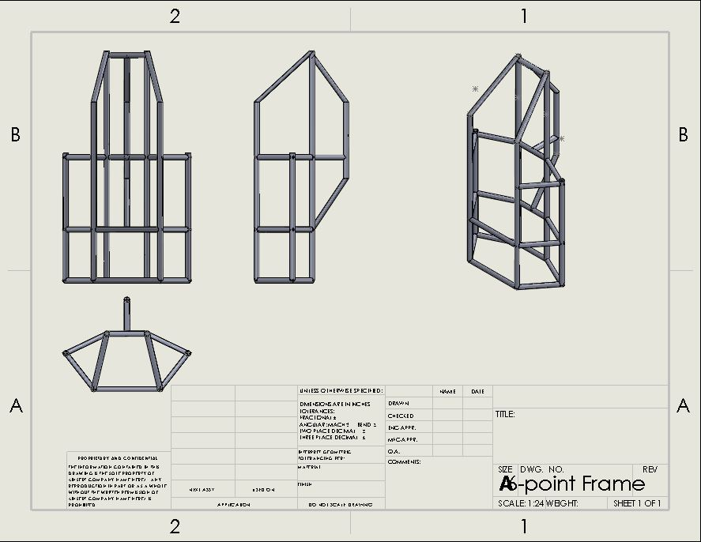
Updated Frame Designs
Concept 1 Concept 2

Slide 3
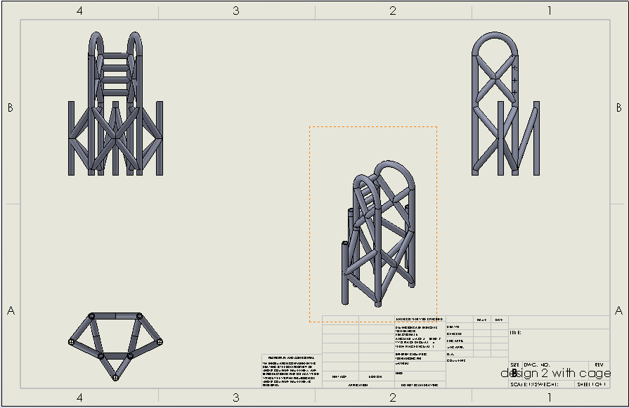
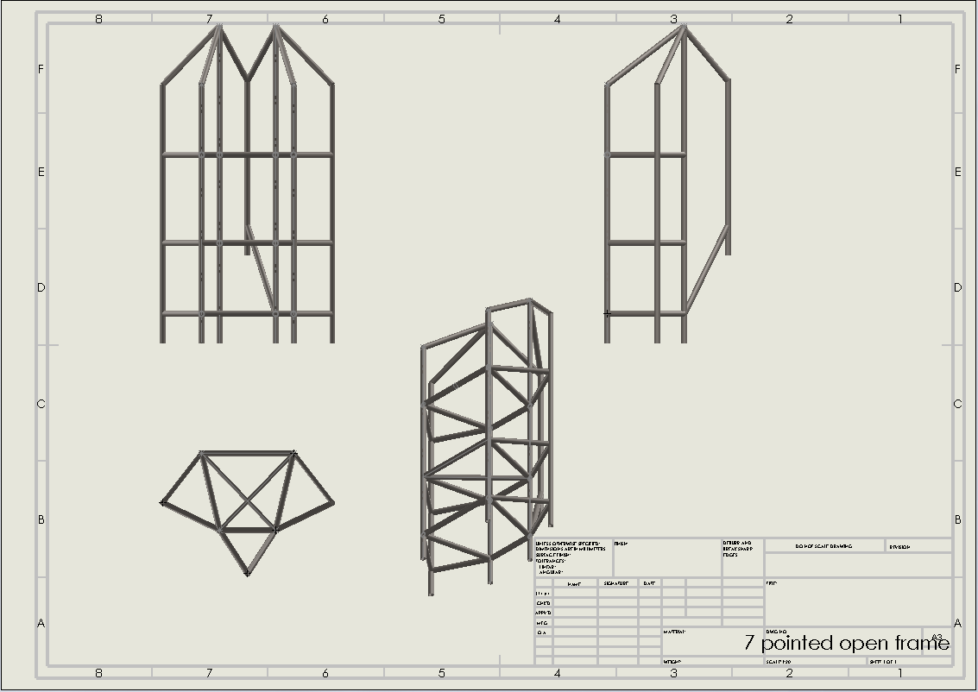
Updated Frame Designs
Concept 3
Concept 4

Slide 4
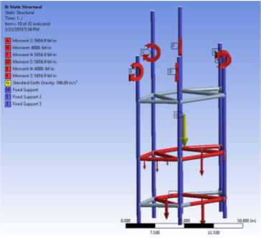
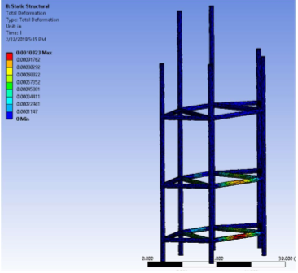
Updated Ansys Analysis
Hardware Review 1 - Prior to Fixed points
Hardware Review 1 -Multi-point results

Slide 5
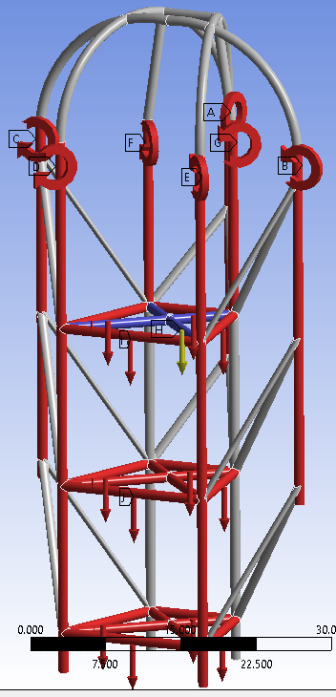
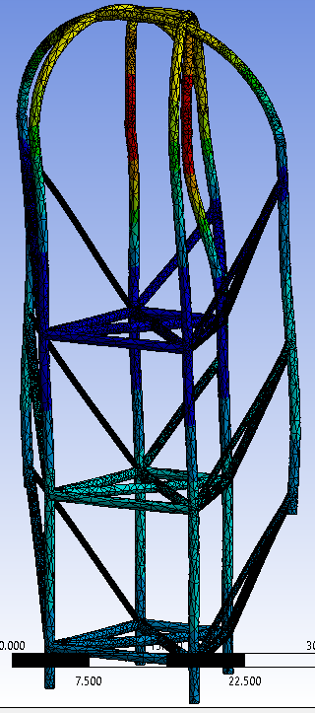
Updated ANSYS ANALYSIS
Single Fixed point - Concept 1
Single point deformation - Concept 1

Slide 6
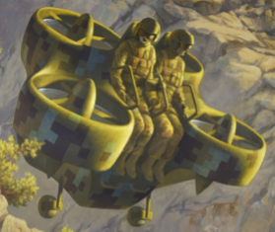
Additional Meeting Minutes
Feb. 6th - Staff Meeting , Library
Feb. 9th - Staff Meeting, Novakinetics
Feb. 13th - Team Meeting, Library
Feb. 15th - Client Meeting, Novakinetics
Feb. 22nd - Team Meeting, Online
Feb. 28th - Team Meeting, Online
Mar. 7th - Staff Meeting, EGR Class Rm
Mar. 8th - Team Meeting, Online
Mar. 14th - Team Meeting, Computer Lab
Mar. 28th - Team Meeting, Online

Slide 7
Hardware Review Action Items
Travis: perform more ANSYS simulations for each frame redesign. Compare 7075 Aluminum with the proper 4130 steel properties addition to ANSYS. Continue with 3d printed force model of the Flyer, to help visualize contributions. Finalize ANSYS models under different approved conditions.
Steve: Redesign frames with client and Ansys considerations, Add client additions to the Model frames within solidworks, assist Travis in ansys modeling of proposed frames, Print final proposed frame for client.
Corey: Continue hand calculations once a final frame has been designed, create working code program to test different materials under different boundary conditions, aid in designs for final proposed frame for the client, aid in ANSYS analysis of different frames.
Nathaniel: choose a final design for our client with team. 3D print Fanflyer model. Weigh whether to 3D print at school maker labs or uses Steve’s printer. Transfer designs to ANSYS 19.1 mechanical APDL for additional analysis

Slide 8
Moving Forward
The team will analyze the remainder of their frames and submit them to the client for approval.
Make final client suggested revisions to finish the frame.
Compare the analysis between client frame and proposed frame components and materials to demonstrate areas of improvement.

